Slide 1
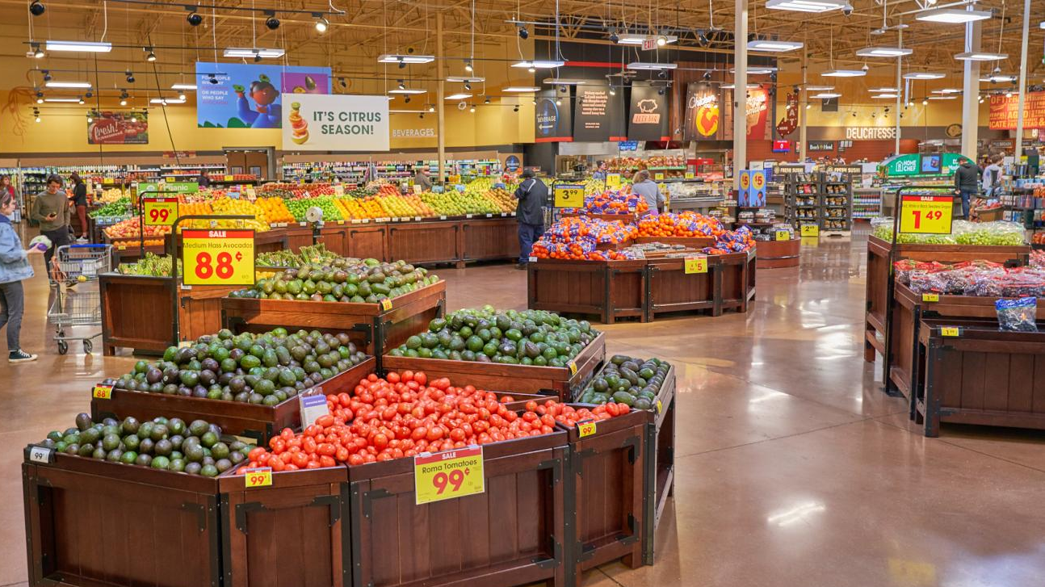
Retail Startup Analysis and Launch Plan
Ben Fujii

Slide 2
Establishing a Target Market
Targeting middle income to high income households
Defining middle income to high income households:
Average income before tax among all households in all cities: $75,655
Min: $60,340 (Tampa)
Median: $88,644
Max: $124,002 (San Francisco)
With this in mind, ideally the city chosen should have an average income before tax between $75,655 and $124,002+

Slide 3
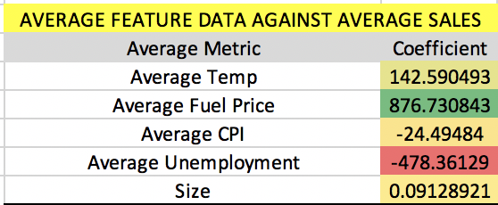
What Makes a Location Attractive?
Little Competition
Few other competitors in the area creates a much smaller barrier of entry.
Look for cities within the data that have a low number of stores, indicating lessened competition
High Average Sales
Locations that have a high average sales number is obviously desirable
Look into factors that correlate to the average sales number
The table on the right depict results from a regression model (68.7% R2) predicting for average sales against the averages of various metrics specifically, temperature, fuel price, CPI, unemployment, and store size, showing the correlation these metrics had with the average sales in each city.
Average temperature and fuel price of the city, along with store size
Based on the regression model, these metrics had the highest positive correlation to average price, which makes them important metrics to consider when deciding on locations
Average Annual Expenditures per household
Cities with a high average annual expenditure number indicate a larger overall market and high demand, signifying a high potential for growth and profits

Slide 4
The Top 10 Markets to Enter Into:
1. San Diego
2. Seattle
3. Atlanta
4. Washington D.C.
5. Chicago
6. San Francisco
7. Salt Lake City
8. Kansas City
9. Philadelphia
10. Denver

Slide 5
Market #1: San Diego
Low competition within the market
Second lowest number of stores, as depicted on graph
16,646 total stores compared to the average of 29,383 stores
Little competition lowers the barrier of entry in this market, resulting in a much higher potential for growth
Average income before tax of $99,931, which falls within our target market
Significant expenditure in San Diego
Has the third highest average expenditure among potential markets
$79,585 compared to the average of $67,913
Indicates the significant demand within the city
High demand in combination with low competition makes a perfect formula for entering the retail industry, as there is massive potential for growth

Slide 6

Market #1: San Diego Cont.
Launch Plans
Breakdown of Expenditures:
Food at Home
$5,364
Household Furnishings and Equipment
$3,200
Personal Care Products and Services
$1,086
Based on this data, it is clear that the store should be focusing on the grocery side of things, followed by household items, and personal care products respectively

Slide 7
Market #2: Seattle
Average Annual Expenditure is highest by a significant margin
$83,790 with the next highest being $79,921
Indicating a massive demand, which is critical when deciding upon potential markets to enter
As depicted in graph below
Income before taxes is well within target market
$117,844
Expenditure breakdown:
Food at Home
$5,978
Household Furnishings and Equipment
$2,524
Personal Care Products and Services
$841
Based on how exactly consumers in the Seattle area focus their expenditure, it is clear that food is a major focal point in spending, while the household furnishings and equipment are high
When it comes to launching, the store should focus on groceries and household items, and place less of a focus on personal care products, as spending for that category was fairly low

Slide 8
Market #3: Atlanta
The extremely high coefficient indicates that the market of Atlanta has a significant positive impact on average sales, making it an extremely attractive potential location
Other Indicators
Average Temperature: 66.36
Average of all cities: 59.36
Average Unemployment: 6.87
Average of all cities: 7.82
High temperature and low unemployment indicate higher average sales, according to regression model mentioned on slide 3
Income before tax of $90,502 which is within the target market
Expenditure breakdown:
Food at Home: $3,699
Household Furnishings and EQ: $1,904
Personal Care Products: $670
Overall, relatively low expenditure for all three despite the high average sales, but household furnishings and equipment are relatively high in comparison to other cities, so that should be a point of emphasis for the launch of the store
In a regression model that predicts average sales based on the city the store is in, Atlanta had the highest positive impact on average sales
Atlanta had a coefficient of 10,738.36, indicating that if the store was located in Atlanta, the average sales would increase by an estimated $10,738.36 from the average
The second highest coefficient was 9,861.43

Slide 9
Market #4: Washington D.C.
Second highest average annual expenditure
$79,921, just ahead of San Diego at $79,585
High average expenditure indicates high potential demand, which is critical when entering a new market
Extremely high income before tax of $113,834 which is well within target market
Expenditure breakdown:
Food at Home
$4,703
Household Furnishings and Equipment
$1,851
Personal Care Products and Services
$1,018
High food at home and personal care products indicate that those categories should be points of emphasis when launching a store in the market

Slide 10
Market #5: Chicago
However, the income before taxes is slightly below the target market
$76,639
Expenditure breakdown:
Food at Home
$4,518
Household Furnishings and Equipment
$1,844
Personal Care Products and Services
$ 958
With expenditure being relatively high in personal care products compared to the average across all markets ($850.95), it will be important to focus on this category when launching into the market
High average temperature and low average CPI
Based on the coefficients on slide 3, this indicates that these predictors have positive affects on average sales, making the market more desirable
Second highest coefficient in the regression model that ran the city of the store against average sales
Coefficient of 9,861.44 with the next highest being Dallas at 9,342.18
Slightly under the average of total number of stores in the market
29,038 compared to the average of 29,383 indicating a slight positive of less competition in the city, lowering the barrier of entry

Slide 11
Market #6: San Francisco
Fourth highest average annual expenditure per city
$79,291 which is slightly below San Diego, which is at $79,585, and well above the city ranked one below at $74,316
This significant average expenditure indicates that there is massive demand and high overall spending in San Francisco, making it an ideal location to open a store
Income before taxes well within target market
$124,002
Expenditure breakdown
Food at Home
$4,487
Household Furnishings and Equipment
$2,373
Personal Care Products and Services
$949
The categories of household furnishings and equipment and personal care products are both above the averages among all cities, indicating that these are the two product types that should be focused on in stores upon launch

Slide 12
Market #7: Salt Lake City
The combination of the two results in Salt Lake City being extremely attractive, as there is little competition and the city itself has a strong positive impact on average sales
Low average unemployment and average CPI, which are both factors that were shown to have positive affects on average sales
Least competition among all cities
15,804 total stores in the market, well below the average of 29,383
One of the best locations due to the extremely low barriers of entry
Also has a strong coefficient in the regression model that looked at how the city impacts average sales
Fifth highest coefficient at 5,572.46

Slide 13
Market #8: Kansas City
Having the small barrier of entry in combination with a relatively decent coefficient, the market is attractive for a new entrant, which is exactly what we are looking for
Expenditure data is unavailable, so it will be important to focus on specific categories later after launch after more data is available
Third fewest competition within the market
17,166 stores which is well below the average of 29,383
Average coefficient in the regression model that examined a city’s affects on average sales
Still above San Diego, which was a similar type of market, given its low competition

Slide 14
Market #9: Philadelphia
Income before taxes within target market
$88,874
Expenditure breakdown
Food at Home
$4,857
Household Furnishing and Equipment
$1,775
Personal Care and Services
$756
Food at home is above the average among all cities, indicating that this category should by focused upon upon launch of the store
Relatively small competition with 20,198 stores in the market compared the average of 29,393 stores
Lower barrier to entry into the Philadelphia market
Coefficient in the regression model is 3,949.27 indicating that the city of Philadelphia has a positive affect on average sales

Slide 15
Market #10: Denver
Income before taxes well within target market of $105,790
Above average in indicators that have positive affects in average sales
Average fuel price slightly above average at $3.42
Average CPI below average at 164.06
Average unemployment below average at 6.67
Expenditure breakdown
Food at Home: 5,057
Household Furnishings and Equipment: 2,270
Personal Care Products and Services: 1,215
All three categories well above the industry averages, indicating that all three should be evenly focused on upon launch, however personal care items could be slightly heavily favored due to the percentage increase in demand for this category is slightly higher than the other two
High overall average annual expenditure
6th highest city and well above average at $74,088
Above average coefficient in the regression that examined the impact the city has on average sales
Coefficient of 5,116.26 compared to the average of 4,494.02
The combination of a high average expenditure with a high coefficient when predicting for average sales indicate that Denver is an excellent option as there is high demand coupled with the city of Denver having a positive affect on sales

